Slide 1
Re-imagining Mining Sites: Kennecott North and South Zones
Kerri Fiedler
Remedial Project Manager
EPA Region 8

Slide 2
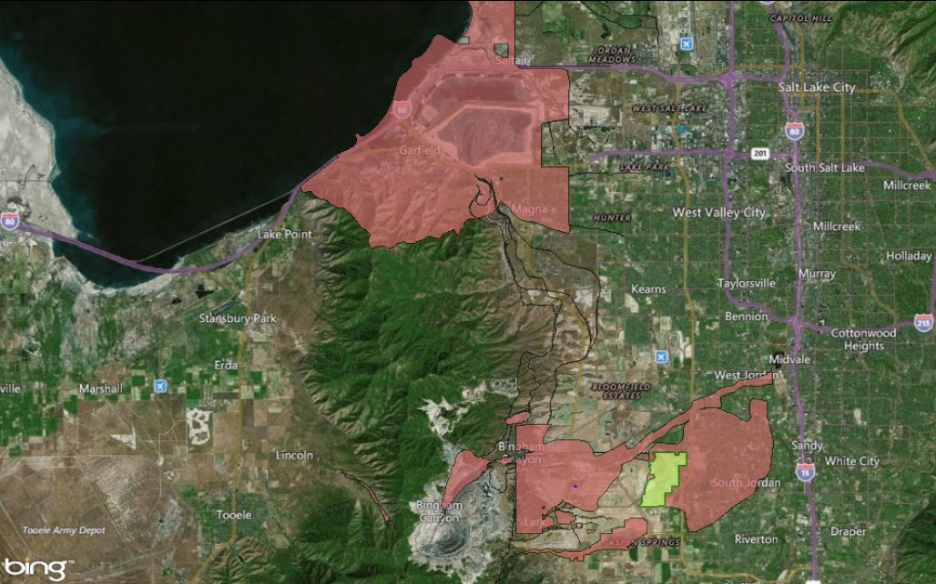
Great Salt Lake
North Zone
South
Zone
Daybreak
Kennecott Utah Copper: NPL areas of interest and surrounding areas.
Notes:
Kennecott (North Zone) and Kennecott (South Zone) are located near Salt Lake City, Utah. A legacy of mining has altered the landscape over approximately 110 years, carving into the mountains forming Bingham Canyon Mine and building up infrastructure to support mining activities. The legacy and current operations span approximately 96,000 acres along the Oquirrh Mountains, with:
The Kennecott South Zone focused around the mining, milling, and waste management facilities associated with the Bingham Canyon Mine
The Kennecott North Zone focused around the legacy milling, current refining and smelting, and waste management facilities near the shoreline of the Great Salt Lake.
Currently ore mined in the South Zone is transported to the North Zone via a slurry pipeline that connects the two zones. The ore is then smelted and refined in the North Zone. In the past these two zones were connected by a series of railroads.
This map primarily shows the features of the Kennecott zones and surrounding areas:
Kennecott North Zone is located west of Salt Lake City, and includes the Township of Magna.
Kennecott South Zone is located southwest of Salt Lake City and includes the Town of Copperton, and portions of the Cities of West Jordan, South Jordan, Riverton, Herriman, and un-incorporated Salt Lake County.
The two zones are broken up into 24 Operational Units (OUs), 8 OUs in the North Zone, 15 OUs in the South Zone. Breaking up a large site into smaller parts helps the design and cleanup become more manageable and effective.

Slide 3
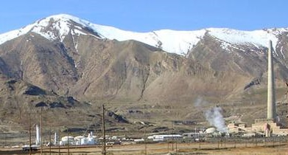
Kennecott North Zone Background
Smelter processed metal-bearing ores.
Activities related to mining contaminated soils, sludge, surface water and groundwater.
The Kennecott North Zone was proposed for NPL listing in 1994.
Cleanup as well as active mining operations are ongoing.
Kennecott North Zone (Source: EPA)
Notes:
Since 1906, areas within this zone were used to process copper, molybdenum, gold and silver-bearing ores which contained various concentrations of other heavy metals including arsenic, cadmium, lead and selenium as byproducts.
The legacy milling, and current refining and smelting operations produced wastewater, sludges, slimes, tailings, slag, and aerial particulate deposits which lead to impacts on surrounding soil, surface water drainages, underlying shallow and principle aquifers, and nearby wetlands. The main contaminants of concern are lead, arsenic, and selenium.
As a result of this widespread contamination, the Kennecott North Zone was proposed to the National Priorities List (NPL) in 1994, however the site was not finalized on the NPL. Kennecott North Zone has employed the same alternative approach as the Kennecott South Zone, which will be discussed later.
Cleanup as well as active mining operations are ongoing.

Slide 4
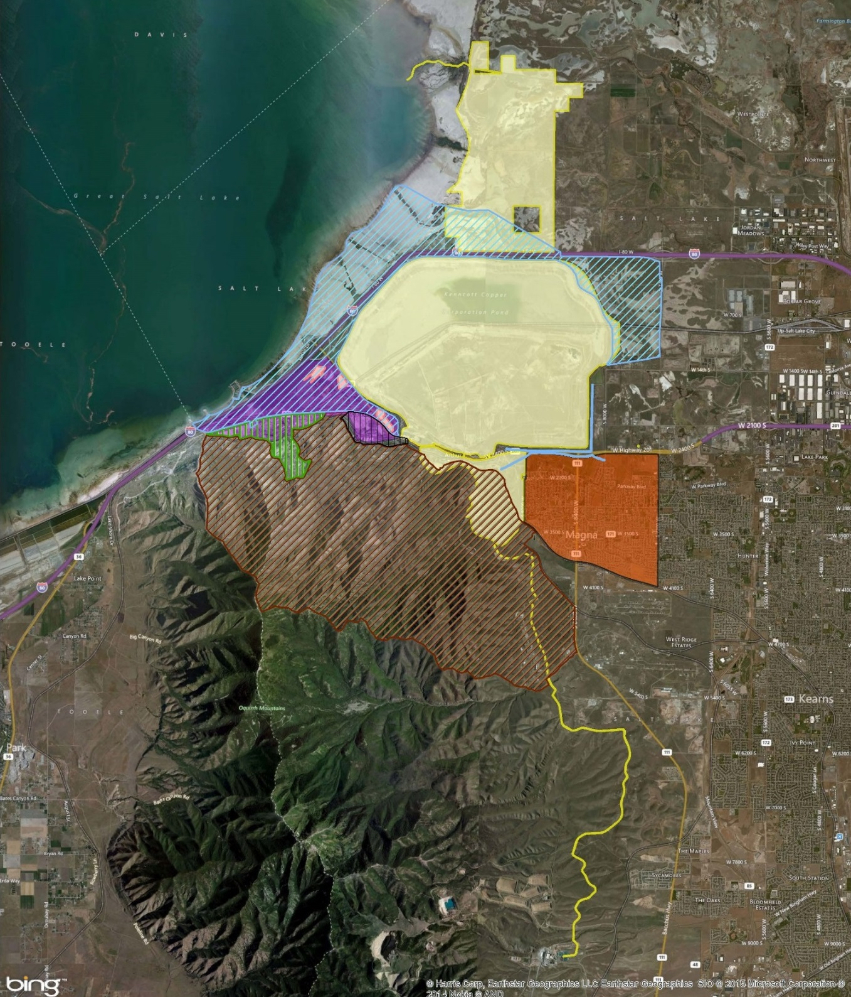
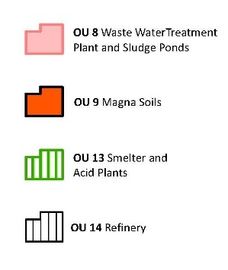
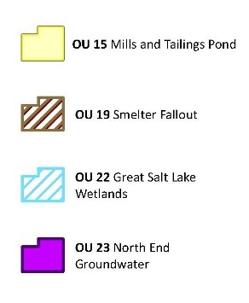
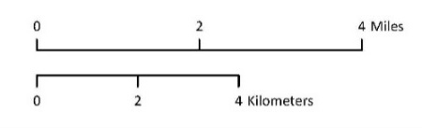
Notes:
This is a map of the 8 OUs in the North Zone.
In addition to the long term management of waste left in place, a particular source of concern is a series of non-contiguous groundwater plumes containing arsenic and selenium in concentrations above wildlife surface water protection standards.
The impacted groundwater underlying the Refinery and Smelter enters nearby wetlands through springs and seeps.
Native birds in the wetlands are sensitive to selenium, and could be affected by elevated arsenic concentrations.
Rio Tinto Kennecott Copper (RTKC) is currently evaluating remedies and protection measures for the North End groundwater plumes and the wetlands.

Slide 5
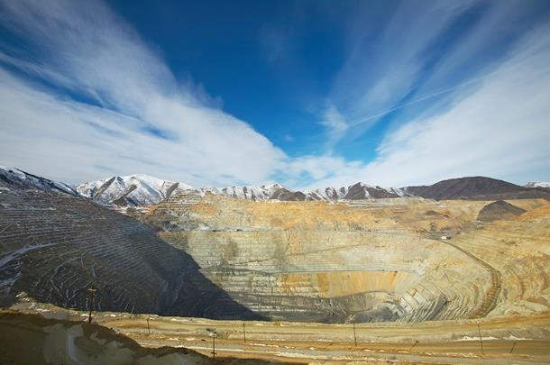
Kennecott South Zone Background
Mining activities began in the 1860s.
Operations produced copper, molybdenum, gold and silver ores.
Rio Tinto Kennecott Copper currently operates the mine.
Bingham Canyon Mine (Source: Rio Tinto)
Notes:
The Kennecott South Zone includes the Bingham Canyon open pit mine, associated waste rock dumps, the Copperton Mill and other historic sites. Mining activities at the site began in the 1860s and continue today. Operations produced copper, molybdenum, gold and silver ores for further processing, with byproducts including arsenic, cadmium, lead and selenium.
Contamination is found in waste rock, tailings, acid mine drainage, process waters, sludges and slimes.
Reuse of waste material (particularly slag) also left a legacy of residual metals around the South Zone.
Contamination in soils, sediments and groundwater are above risk based action levels.
Again, cleanup as well as active mining operations are ongoing.

Slide 6
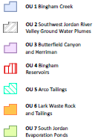
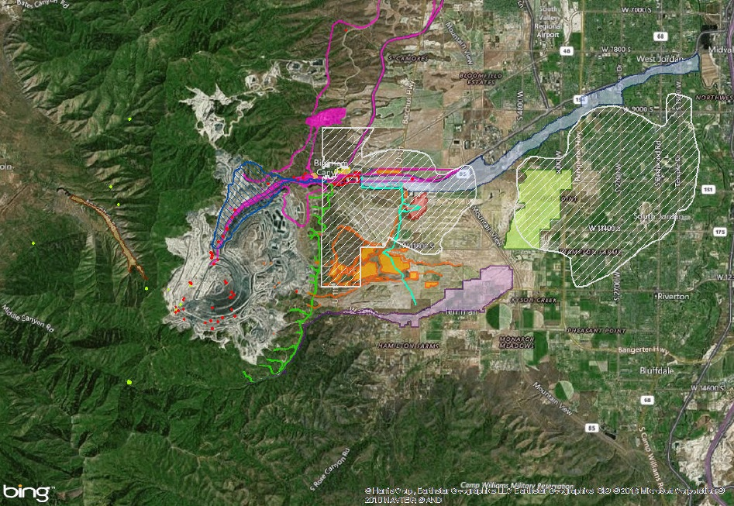
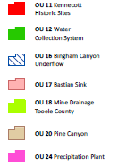

Notes:
This is a map of the 15 OUs in the South Zone.
In addition to the soil and sediment concerns (which are managed during changes in land use), a large portion of the principle aquifer in the southwest quadrant of Salt Lake Valley was impacted by previous mining practices.
Underlying approximately 72 square miles, the two plumes of mining impacted groundwater contain sulfate and total dissolved solids above the State of Utah’s Primary Drinking Water Standards.
The Zone A Plume (western plume closer to the mine) has a pH around 3 (acidic) and contains metals above the State of Utah’s Primary Drinking Water Standards.
The plumes are being addressed under a CERCLA remedy and a State Of Utah led Natural Resource Damage restoration project, in partnership with Kennecott, Jordan Valley Water Conservancy District, and the Communities of West Jordan, South Jordan, Riverton and Herriman (who are impacted by the groundwater plumes).

Slide 7
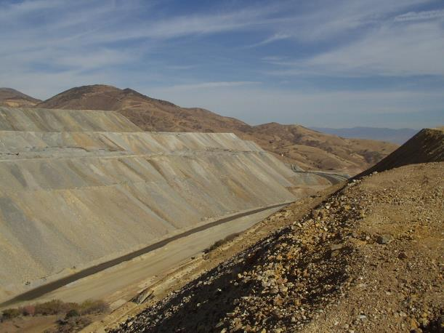
Kennecott South Zone Background (cont.)
Mining operations led to widespread contamination of soil and groundwater.
In 1994, EPA proposed the site for inclusion on the NPL.
Bingham Canyon, Kennecott South Zone (Source: EPA)
Notes:
Decades of mining operations led to widespread contamination of soil and groundwater at the Kennecott South Zone. Miners historically deposited mining wastes in nearby creeks and on valley slopes, which later eroded and washed downstream.
Beginning in the 1990s, EPA and the Utah Department of Environmental Quality (UDEQ) discovered homes downstream of the mining district had been built in floodplains and in proximity to creek channels and irrigation ditches.
These areas were found to be impacted by high levels of arsenic and lead above applicable risk based action levels for various land uses.
Similar to the North Zone, the South Zone was proposed to the NPL in 1994, but the listing was not finalized.
An alternative approach was used (as Doug Bacon with the State of Utah will detail next), which subsequently lead to the delisting of the proposal package in 2009.
Cleanup continues as an Superfund Alternative Site, under a series of consent decrees.

Slide 8
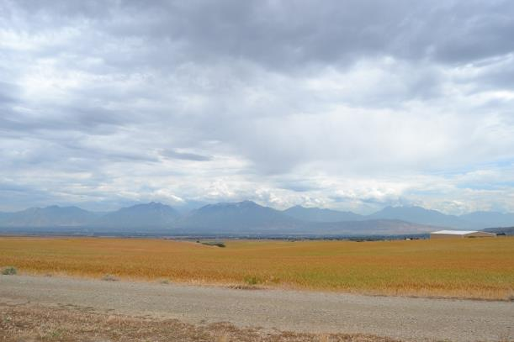
Kennecott Paves the Way
EPA, UDEQ, and Kennecott initiated a process to address implementation of remedial efforts for quicker cleanup.
Memorandum of Understanding (MOU) – 1995
Leads to the Superfund Alternative Approach
Kennecott reclaimed land. (Source: EPA)
Notes:
Forming the foundation for future response actions, in 1995, EPA, the State of Utah Department Of Environmental Quality and Kennecott agreed to a Memorandum of Understanding (MOU) which stated:
EPA would not finalize the NPL listing for the Kennecott North and South Zones if Kennecott agreed to complete all required investigations and cleanup work,
Kennecott would implement certain investigatory actions to determine nature and extent of contamination, complete certain voluntary cleanup actions, and coordinate with the agencies over time,
UDEQ and EPA would avoid duplicative oversight, and utilize state groundwater authority to oversee current operations and the management of legacy waste issues.
This resulting collaborative effort and implementation of successful remediation would influence the development of a voluntary cleanup process that would be called the Superfund Alternative Approach.
The Superfund Alternative approach uses the same standards for investigation and process for cleanup as a standard Superfund site, except that the PRP funds the cleanup. If the PRP fails to meet the obligations of the Superfund Alternative agreement, EPA may move forward with listing the site on the NPL.

Slide 9




OU 2
OU 2
OU 17
OU 17
OU 1
OU 1
OU 7
7
Daybreak
Notes:
As part of the Superfund Alternative Approach, Kennecott, EPA and UDEQ worked together to cleanup OUs to various land use action levels.
The Daybreak community falls in portions of OUs 1, 2, 7 and 17.
The area of Daybreak is within the boundaries of South Jordan City which was settled in 1859. South Jordan City was a farming community during its early existence. With development pressure and a population increase in the Salt Lake Valley area, the community has become a hot bed of redevelopment for residential, commercial and open space.
My colleague, Doug Bacon with UDEQ will next discuss the cleanup of the broader Kennecott Zones and specifically the Daybreak community. Then, John Birkinshaw with RTKC will discuss the remarkable redevelopment creating a master planned community, Daybreak.

Slide 10
For More Information, Contact
Kerri Fiedler
Remedial Project Manager
EPA Region 8
Phone: 303-312-6493
Email: fiedler.kerri@epa.gov

